Slide 1

Snail Games

Slide 2

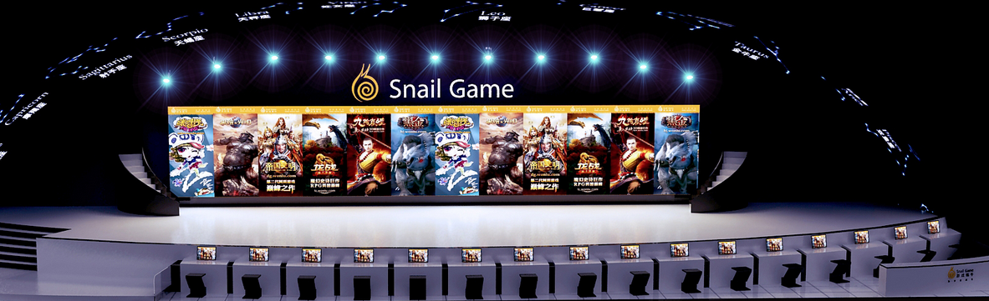
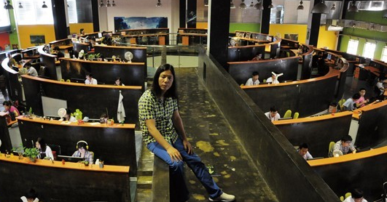
ABOUT SNAIL GAMES
Snail Games, a part of Suzhou Snail Digital Technology Co Ltd, has been a pioneer in the Chinese digital technology and entertainment industry since its founding in 2000. The company has developed and published over 50 digital products, providing entertainment to 85 million users in over 100 countries and regions. As the mobile era continues to accelerate, Snail Games aims to expand the scope of gaming through innovations in software, hardware, and telecommunications.

Slide 3
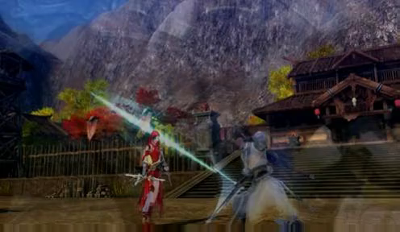


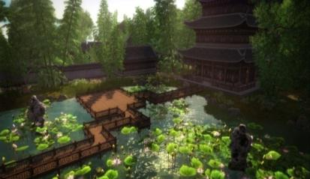
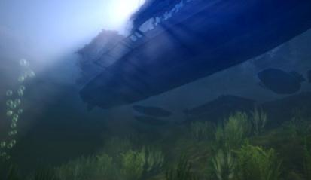
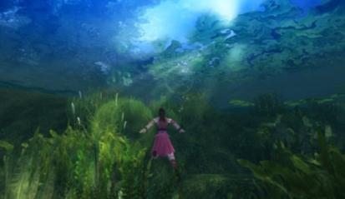
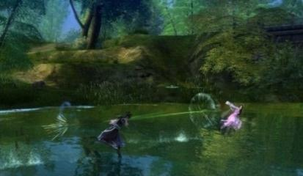
Technological Development
Snail Game have the top ability of virtual digital engine technology in the world. Snail Game has successfully developed engines with independent intellectual property rights, including marine engine, D1XN engine, fly cents (Flexi) engine, Snail digital tour page client engine, Snail digital page tour service engine, Snail flat-panel digital mobile terminal engine, Film shooting related editing system and Digital virtual engine.
高动态范围光照技术
模拟特殊气候场景
水面阳光反射
水下真实体积光照
水下物体折射
水面水花效果

Slide 4


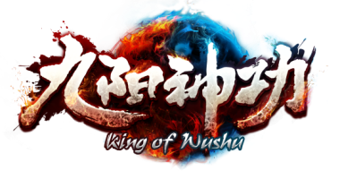








Our company's game has 3 aspects, PC client games, mobile phone games, and TV client games.
Most of them are Chinese culture style, martial arts, Three Kingdoms and other topics.
And we have achieved very high performance.
For example, jiuyinzhenjing has a maximum number of 40w of concurrent users.

Slide 5
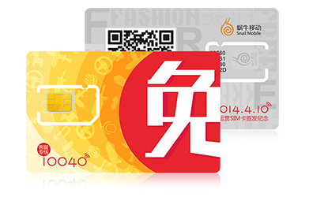
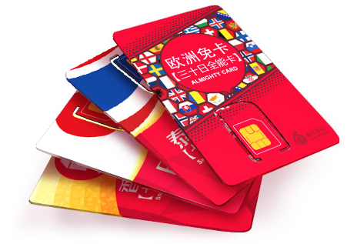
ABOUT SNAIL MOBILE
In January 2014, Snail Games made its formal entry into the telecommunications industry when it became the first Chinese video game company to receive a mobile virtual network operator (MNVO) license. Building on Snail’s extensive experiencing in designing, producing and operating video game products, Snail Mobile was formed, unveiling revolutionary new ideas and principles to the industry and providing an impressive lineup of mobile telecom products and hardware specially designed for gamers.

Slide 6
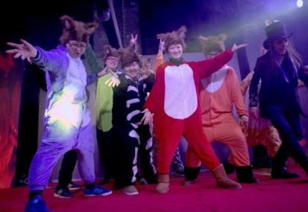
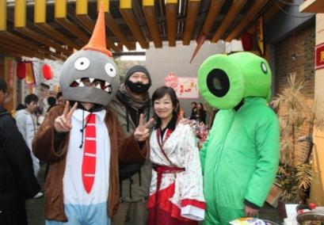
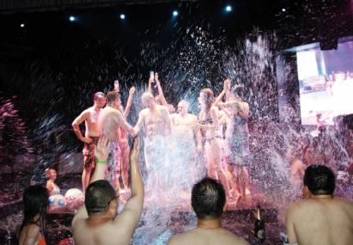
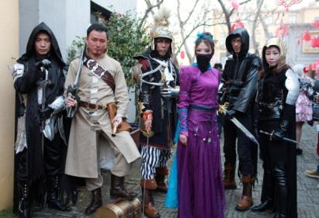
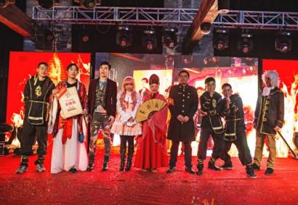
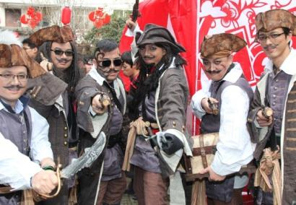
Different Culture
Snail digital always believe that if you want to entertain the public, you must entertain yourself first. Only the company witch has strong entertainment spirit can create a better digital entertainment products for more people. So the Snail Digital continuous whim and hold cosplay enterprise annual meeting, bikini party, through this to create belong to the DNA of snail digital culture. The Company will use this spirit of entertainment in the company's products to motivate employees burst maverick innovation ability.

Slide 7

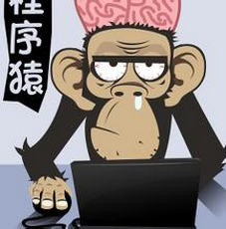

About Me
Lucubrate
Profession
Primer
I have got my bachelor’s degree at hefei university of technology. my major is computer science and technology. I very like C/C + + language and the software engineering lesson. When I in Grade 3, I got two job offers form my teachers. I chose the game development job, and work till now.
Now I work in suzhou snail game, our company makes a lot of famous game, like九阴真经,九阳神功,天子,太极熊猫 and so on.

Slide 8
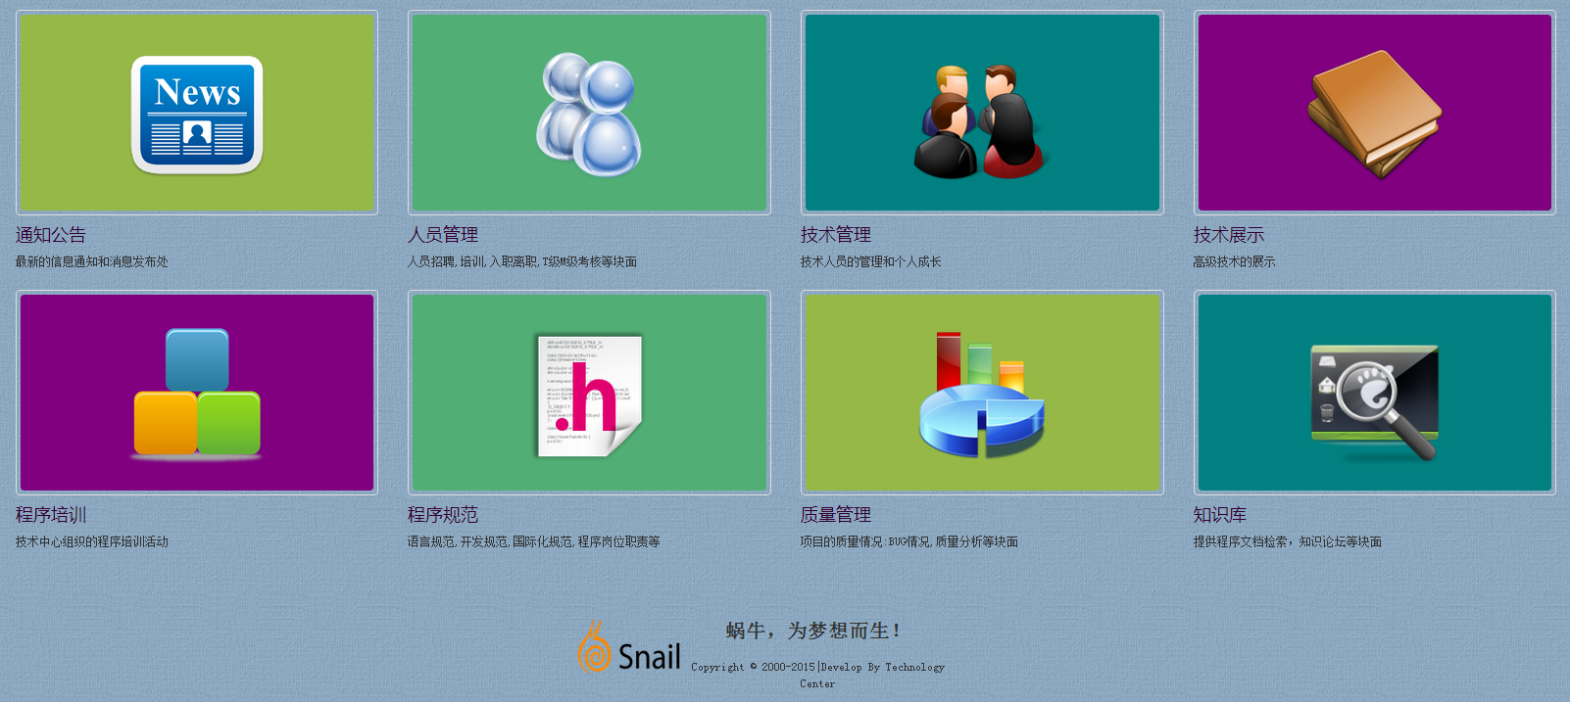
我的管理工作内容
6 years ago, I joined in the九阴真经project, coding for game server. last two years, I went to the technology center,did some management work. Mainly in the Coding standards, the project quality, performance optimization, And the programmer's interview, training, Management works .
Outside of work I love reading books, about technology, management. And I like swimming, singing, travelling, and make friends.

Slide 9


